Slide 1
Calculating the median
Numerical summaries of data

Slide 2
how to use Oak lessons

Slide 3
I can calculate the median from data presented in a frequency table and different graphs.

Slide 4
The median is the central (middle) piece of data when the data are in numerical order. It is a measure of central tendency representing the average of the values.
Data are a collection of information.
The frequency is the number of times an event occurs; or the number of individuals (people, animals etc.) with some specific property.

Slide 5

Calculating the median
Median from a line graph
Median from an ungrouped frequency table
Median from a bar chart

Slide 6
Median from a line graph
Data has been collected about the number of days of frost in February over nine different years.
Year | 1941 | 1951 | 1961 | 1971 | 1981 | 1991 | 2001 | 2011 | 2021
Number of days of frost | 13 | 2 | 0 | 3 | 12 | 16 | 11 | 1 | 9

Slide 7
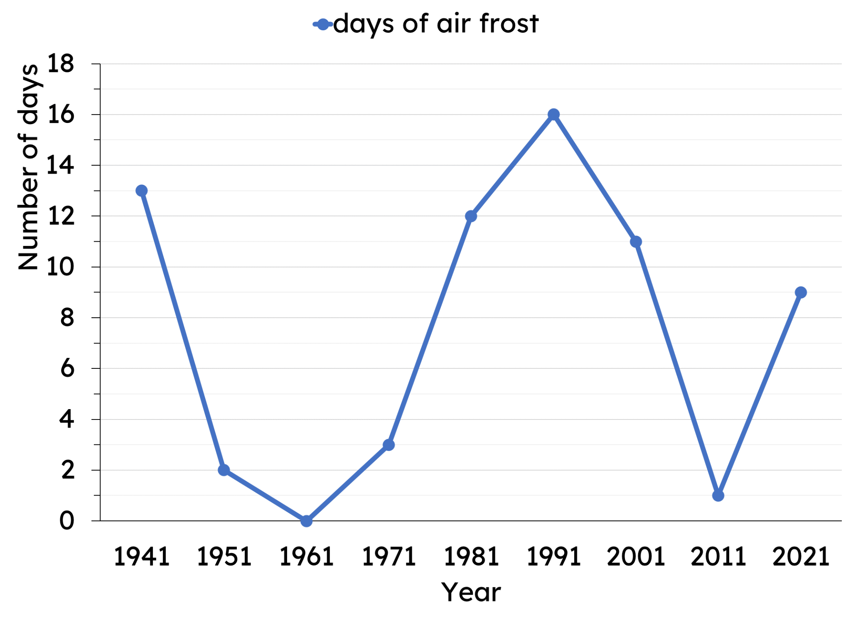

Median from a line graph
The same data can be represented as line graph or a time-series graph.
Where is the median?
a
middle of the vertical data
b
middle of the horizontal data
middle of the ordered raw data
c
The median will be the middle of the ordered raw data.

Slide 8
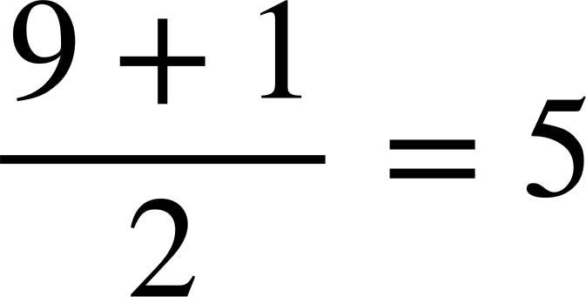
Median from a line graph
The same data can be represented as line graph or a time-series graph.
What is the median number of days frost?
0
, 1
, 2
, 3
, 9
, 11
, 12
, 13
, 16
b
Position = ^{th}
9 days of frost

Slide 9

Median from a line graph
Where is the median on a line graph?
middle of the horizontal axis
middle of the vertical axis
middle of the ordered raw data

Slide 10
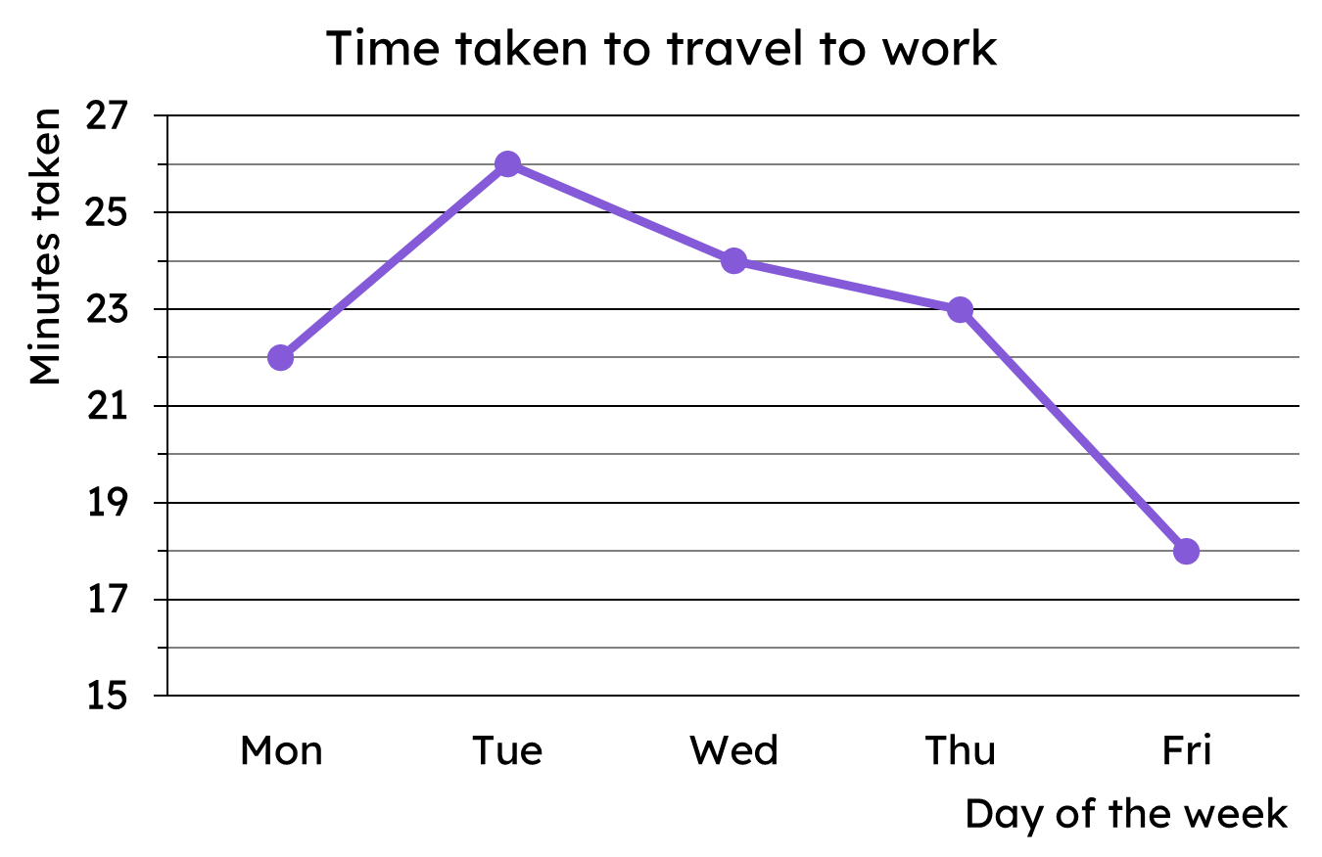
Median from a line graph
This line graph shows the time taken for someone to travel to work over the course of one week.
There are five pieces of data, so the median value is the 3rd piece of data.
3rd
2nd
The median time taken to travel to work is 23 minutes.
1st

Slide 11
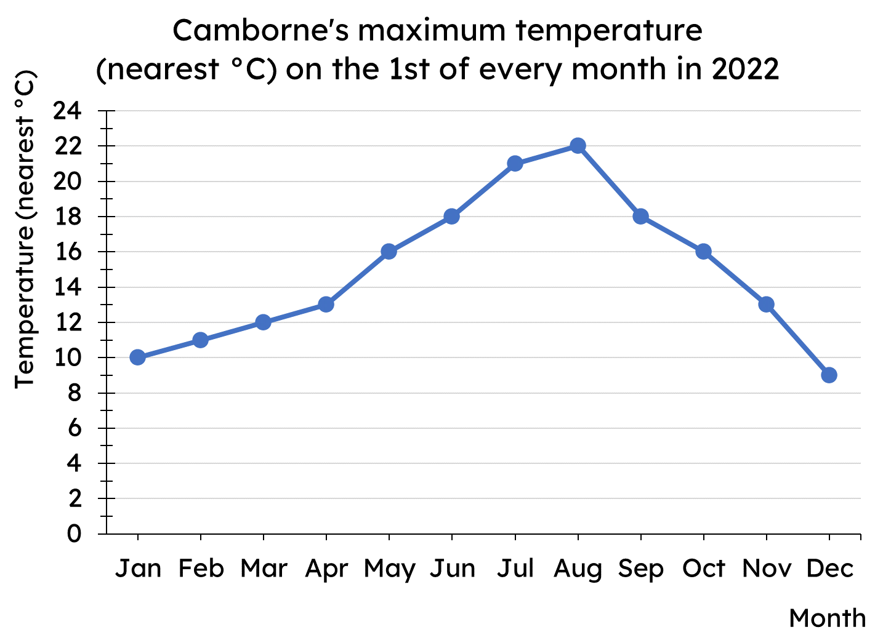
Median from a line graph
What position is the median?
There are 12 data points.
The position will be 6.5th.
The 6th and 7th data will be used to calculate the median.

Slide 12
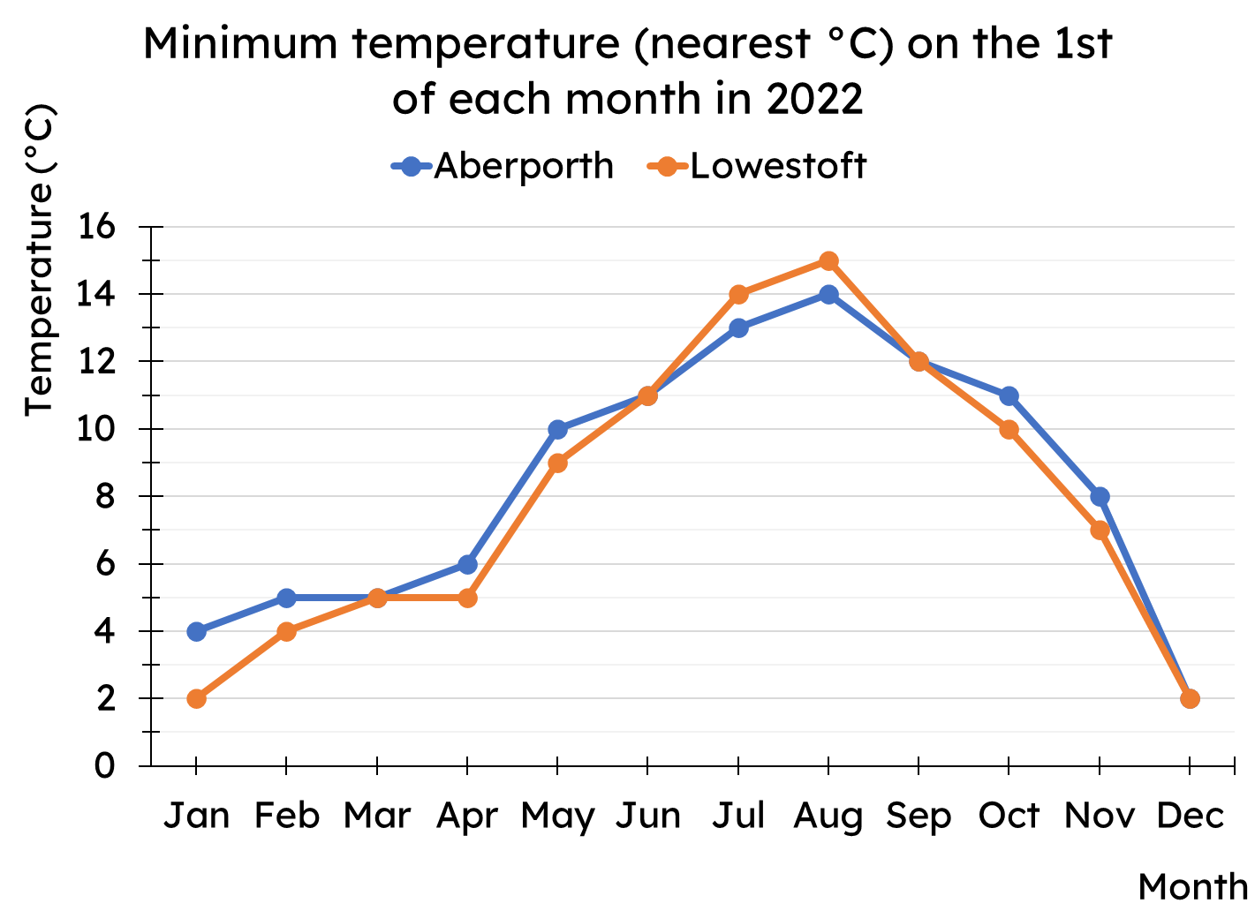
Median from a line graph
Work out the median minimum temperature for both Aberporth and Lowestoft.

Slide 13
Median from a line graph
Work out the median minimum temperature for both Aberporth and Lowestoft.
Aberporth 9°C
Lowestoft 8°C

Slide 14
Calculating the median
Median from a line graph
Median from an ungrouped frequency table
Median from a bar chart

Slide 15
Median from an ungrouped frequency table
The data about group sizes at tables in a restaurant are shown in the frequency table.
group size | frequency
0 | 1
1 | 1
2 | 2
3 | 2
4 | 3
5 | 2
How many tables were empty?
1 table
How many tables had a group size of 1 or less?
2 tables
How many tables had a group size of 2 or less?
4 tables

Slide 16
Median from an ungrouped frequency table
The data about group sizes at tables in a restaurant are shown in the frequency table.
group size | frequency
0 | 1
1 | 1
2 | 2
3 | 2
4 | 3
5 | 2
How many tables had a group size of 3 or less?
6 tables
How many tables had a group size of 4 or less?
9 tables
How many tables had a group size of 5 or less?
11 tables

Slide 17
Median from an ungrouped frequency table
The data about group sizes at tables in a restaurant are shown in the frequency table.
group size | frequency
0 | 1
1 | 1
2 | 2
3 | 2
4 | 3
5 | 2
group size | frequency
0 | 1
1 or less | 2
2 or less | 4
3 or less | 6
4 or less | 9
5 or less | 11

Slide 18
Median from an ungrouped frequency table
The data about group sizes at tables in a restaurant are shown in the frequency table.
group size | frequency
0 | 1
1 or less | 2
2 or less | 4
3 or less | 6
4 or less | 9
5 or less | 11
The data as a list:
0, 1, 2, 2, 3, 3, 4, 4, 4, 5, 5

Slide 19
Median from an ungrouped frequency table
Complete the missing frequency.
group size | frequency
0 | 1
1 | 2
2 | 5
3 | 6
4 | 6
5 | 3
group size | frequency
0 | 1
1 or less | 3
2 or less
3 or less | 14
4 or less | 20
5 or less | 23
8

Slide 20
Median from an ungrouped frequency table
Complete the missing frequency.
group size | frequency
0 | 1
1 | 4
2 | 5
3
4 | 4
5 | 5
group size | frequency
0 | 1
1 or less | 5
2 or less | 10
3 or less | 16
4 or less | 20
5 or less | 25
6

Slide 21
Median from an ungrouped frequency table
The data about group sizes at tables in a restaurant are shown in the frequency tables.
group size | frequency
0 | 1
1 | 4
2 | 5
3 | 6
4 | 4
5 | 5
group size | frequency
0 | 1
1 or less | 5
2 or less | 10
3 or less | 16
4 or less | 20
5 or less | 25
What is the position of the median for these data?
25 pieces of data so median position is 13th

Slide 22
Median from an ungrouped frequency table
The data about group sizes at tables in a restaurant are shown in the frequency tables.
group size | frequency
0 | 1
1 | 4
2 | 5
3 | 6
4 | 4
5 | 5
group size | frequency
0 | 1
1 or less | 5
2 or less | 10
3 or less | 16
4 or less | 20
5 or less | 25
Where is the 13th piece of data? What is the median group size?
The 13th piece of data is a 3. The median group size is 3.

Slide 23
Median from an ungrouped frequency table
The data about group sizes at tables in a restaurant are shown in the frequency table.
The data as a list:
group size | frequency
0 | 1
1 or less | 2
2 or less | 4
3 or less | 6
4 or less | 9
5 or less | 11
0, 1, 2, 2, 3, 3, 4, 4, 4, 5, 5
What is the median group size?
There are 11 pieces of data, so the median is in the 6th position.
The median is 3.

Slide 24
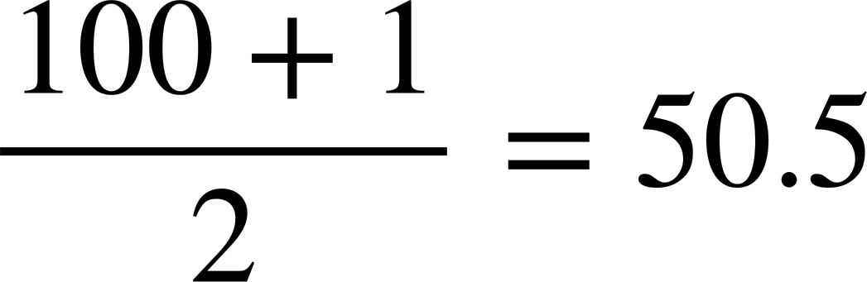
Median from an ungrouped frequency table
The frequency table shows data about the goals scored each match in a football season by all teams in a club.
goals scored | frequency
0 | 19
1 | 34
2 | 21
3 | 15
4 | 11
goals scored | frequency
0 | 19
1 or less | 53
2 or less | 74
3 or less | 89
4 or less | 100
The position of the median is ^{th}
The median number of goals scored is 1.

Slide 25
Median from an ungrouped frequency table
Using the frequency tables, what is the median star rating?
star rating | frequency
1 | 12
2 | 18
3 | 21
4 | 38
5 | 45
star rating | frequency
1 | 12
2 or less | 30
3 or less | 51
4 or less | 89
5 or less | 134
4 stars

Slide 26
Median from an ungrouped frequency table
1) Complete the missing frequencies.
star rating | frequency
1
2 | 25
3
4 | 54
5 | 31
star rating | frequency
1 | 16
2 or less | 41
3 or less
4 or less | 129
5 or less | 160

Slide 27
Median from an ungrouped frequency table
2) Work out the median for these data sets
a)
goals scored | frequency
0 | 12
1 | 27
2 | 43
3 | 37
4 | 10
b)
tube lines | frequency
1 | 204
2 | 53
3 | 19
4 | 5
5 | 3
6 | 1
c)
For each of your answers to parts a and b, justify why your answers are sensible.

Slide 28
Median from an ungrouped frequency table
1) Complete the missing frequencies.
star rating | frequency
1
2 | 25
3
4 | 54
5 | 31
star rating | frequency
1 | 16
2 or less | 41
3 or less
4 or less | 129
5 or less | 160
16
34
75

Slide 29
Median from an ungrouped frequency table
2) Work out the median for these data sets
a)
goals scored | frequency
0 | 12
1 | 27
2 | 43
3 | 37
4 | 10
b)
tube lines | frequency
1 | 204
2 | 53
3 | 19
4 | 5
5 | 3
6 | 1
Median goals scored is 2
Median number of tube lines is 1
c)
For each of your answers to parts a and b, justify why your answers are sensible.
Part a, the data are fairly symmetrical Part b, over 50% of the data are 1

Slide 30
Calculating the median
Median from a line graph
Median from an ungrouped frequency table
Median from a bar chart

Slide 31
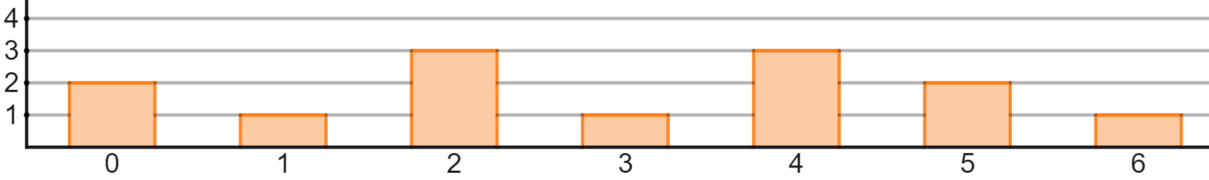
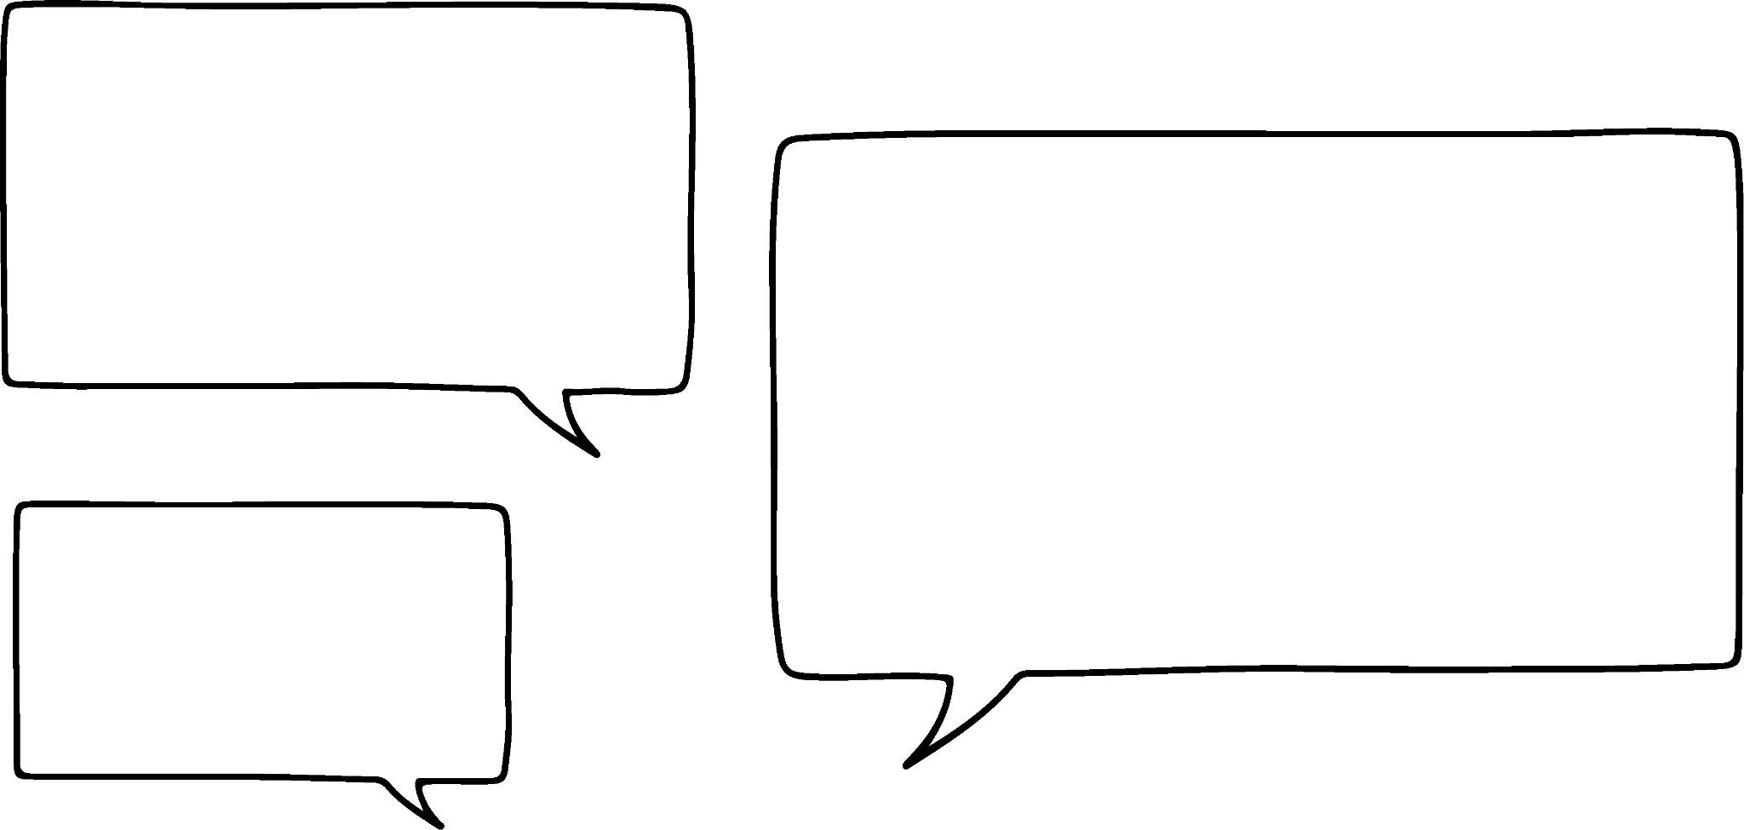

Median from a bar chart
Here is a bar chart that shows the number of each table type in a restaurant.
frequency
diners per table
The data values are 0, 1, 2, 3, 4, 5 or 6.
So the median will be one of them.
Is Jun correct?
He could be, but it could also be the mean of two of them, for example, 3.5.
Jun

Slide 32

Median from a bar chart
Here is a bar chart that shows the number of each table type in a restaurant.
frequency
diners per table
The data values are 0, 1, 2, 3, 4, 5 or 6.
3 is the middle bar, so it is the median.
Is Aisha correct?
She could be, but not for that reason.
Aisha

Slide 33
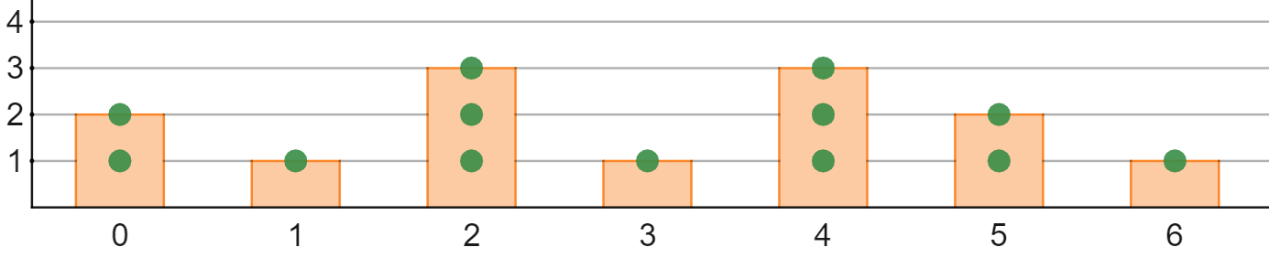
Median from a bar chart
Here is the bar chart with a dot plot overlaid.
frequency
diners per table
The total frequency represents the amount of data values.
2 + 1 + 3 + 1 + 3 + 2 + 1 = 13
13 pieces of data means the 7th is the median.
The median is 3, because the 7th piece of data is 3, not because it is the middle bar.

Slide 34
Median from a bar chart
The median will always be in the middle bar.
The bars are ordered and the median is the middle piece of data
The median will be in the middle (central) position, so it depends on the distribution of the data

Slide 35
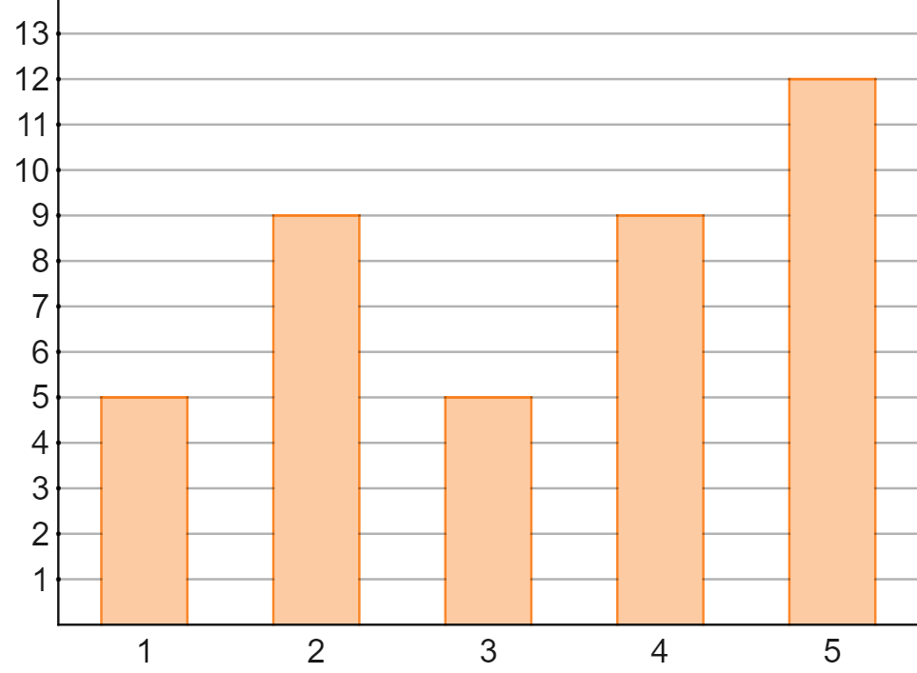

Median from a bar chart
This bar chart shows the reviews of a restaurant.
Frequency
There are 40 pieces of data, so the median is the 20.5th piece.
Sam
Star rating

Slide 36
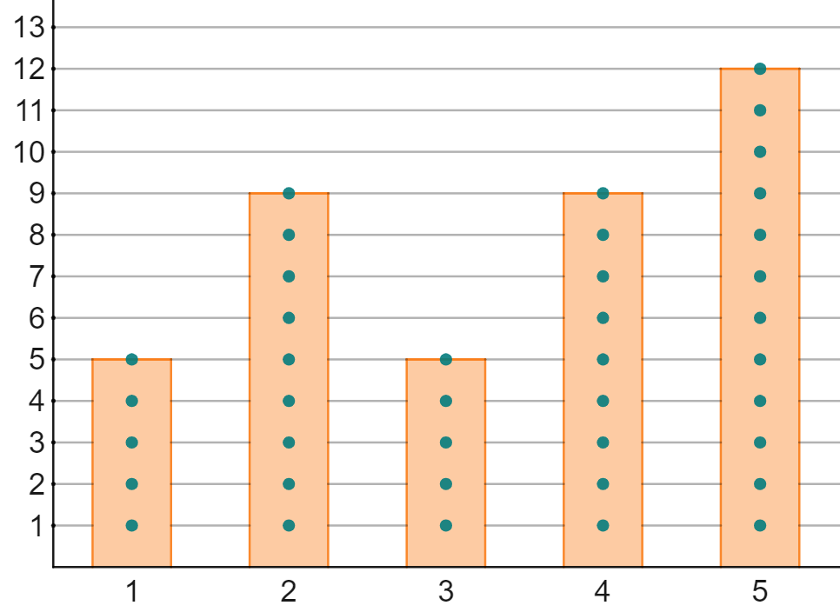
Median from a bar chart
This bar chart shows the reviews of a restaurant.
Frequency
There are 19 ratings of 3 stars or less, so the median must be 4 stars.
Sam
Star rating
19 pieces of data

Slide 37

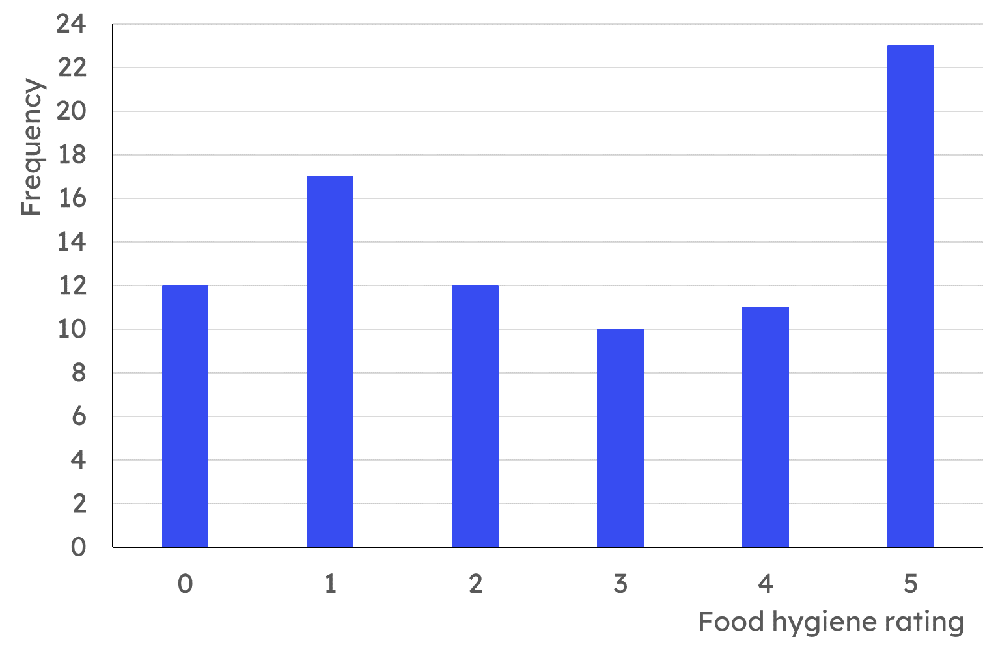
Median from a bar chart
Jacob has calculated the median to be 12.
Why is this not correct?
No restaurant has a food hygiene rating of 12. The median will be within the data.

Slide 38
Median from a bar chart
Here is a bar chart showing the food hygiene ratings for a group of local restaurants.
How many restaurants is this data about?
What is the position of the median?
What is the median food hygiene rating?

Slide 39
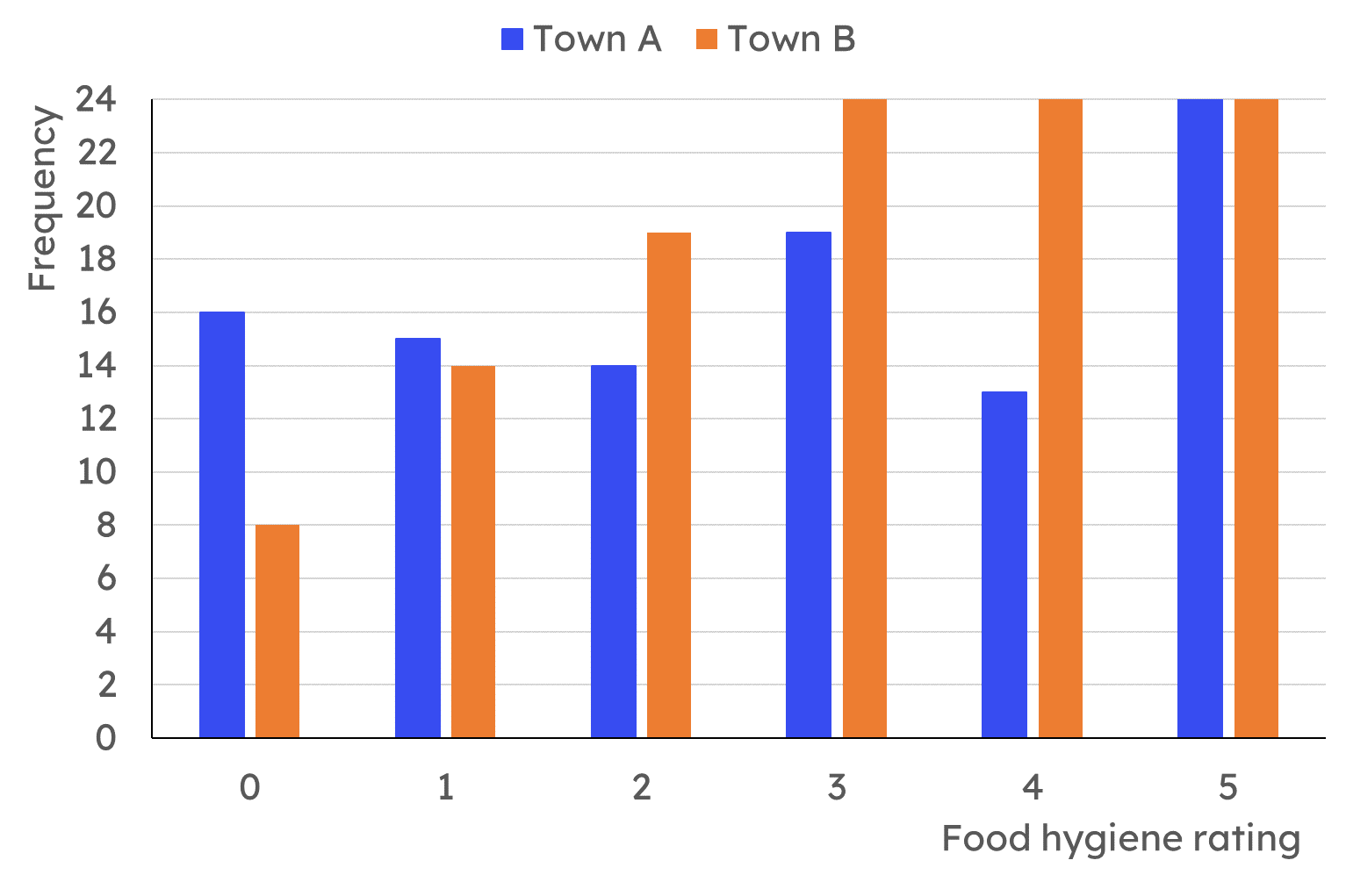
Median from a bar chart
Here is a bar chart showing the food hygiene ratings for restaurants in two towns. Calculate the median food hygiene rating for each town.

Slide 40
Median from a bar chart
Here is a bar chart showing the food hygiene ratings for a group of local restaurants.
How many restaurants is this data about?
85 restaurants
What is the position of the median?
43rd data point
What is the median food hygiene rating?
41 pieces of data
Food hygiene rating of 3

Slide 41
Median from a bar chart
Here is a bar chart showing the food hygiene ratings for restaurants in two towns. Calculate the median food hygiene rating for each town.
Town A:
101 ratings
Median is the 51st value
45 restaurants are 2 or less
64 restaurants are 3 or less
So the median is a rating of 3.

Slide 42
Median from a bar chart
Here is a bar chart showing the food hygiene ratings for restaurants in two towns. Calculate the median food hygiene rating for each town.
Town B:
113 ratings
Median is the 57th value
41 restaurants are 2 or less
65 restaurants are 3 or less
So the median is a rating of 3.

Slide 43
Calculating the median
The median can be calculated from a line graph by ordering the raw data points.
The median can be calculated from an ungrouped frequency table by considering how many data has been accounted for.
The median can be calculated from a bar chart by considering the amount of data as you move through the bars.

Slide 44

© Oak National Academy 2023.
Produced in partnership with Mathematics in Education and Industry.
Licensed on the Open Government Licence v3.0, except where otherwise stated. See Oak terms and conditions.

